Slide 1
Embedded System Course
Lecture 4: Cortex Microcontroller Software
Interface Standard

Slide 2

Lesson Objectives
Understanding basis concepts about Common Microcontroller Software Interface Standard (CMSIS).

Slide 3
Table of contents
What is Software Interface?
Introduction to Common Microcontroller Software Interface Standard.

Slide 4
What is software interface ?
Section 1:

Slide 5
What is software interface
A software interface is used to allow either two pieces of software to communicate with each other (software-software interface), or to allow software to communicate with a hardware device (software-hardware interface).
(wiki)

Slide 6
Common Microcontroller Software Interface Standard (CMSIS) overview.
Section 2:

Slide 7
Common Microcontroller Software Interface Standard
Definition
CMSIS components
CMSIS Structure
Coding Rules
Notes:
General call is:
Master send address with all bit is 0, all slaves that pre-configured to accept general call will receive this command
Commands are defined, e.g. reset devices.

Slide 8
Definition
The CMSIS is a vendor-independent hardware abstraction layer for microcontrollers that are based on Arm® Cortex® processors. The CMSIS defines generic tool interfaces and enables consistent device support. It provides simple software interfaces to the processor and the peripherals, simplifying software re-use, reducing the learning curve for microcontroller developers, and reducing the time to market for new devices.
The CMSIS is defined in close cooperation with various silicon and software vendors and provides a common approach to interface to peripherals, real-time operating systems, and middleware components. The CMSIS is intended to enable the combination of software components from multiple middleware vendors.

Slide 9
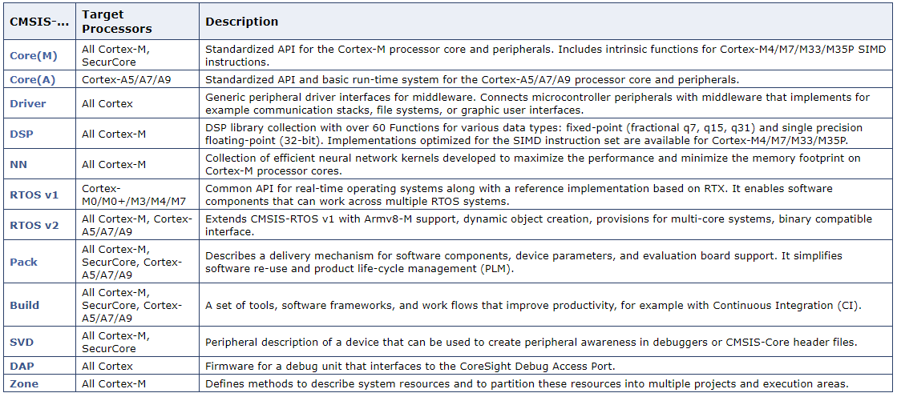
CMSIS components

Slide 10
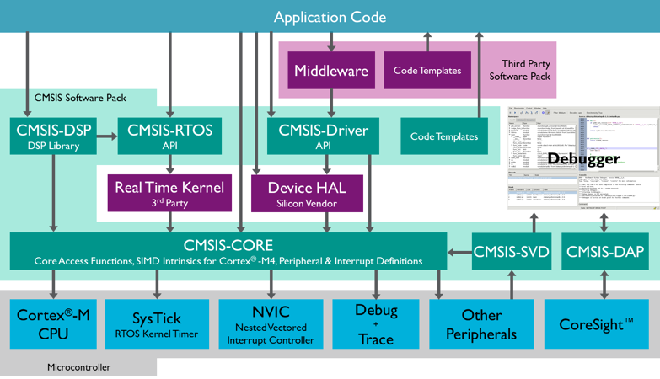
CMSIS Structure

Slide 11
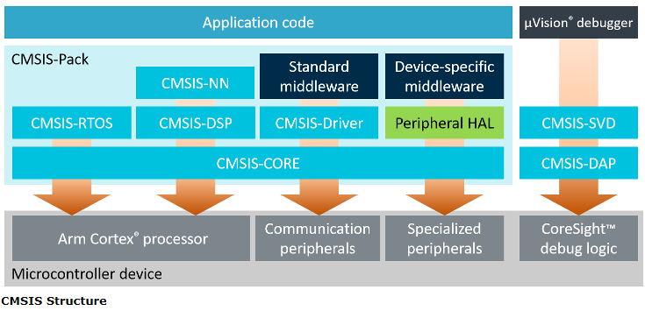
CMSIS Structure

Slide 12
CMSIS Structure
The benefits of the CMSIS are:
- CMSIS reduces the learning curve, development costs, and time-to-market. Developers can write software quicker through a variety of easy-to-use, standardized software interfaces.
- Consistent software interfaces improve the software portability and re-usability. Generic software libraries and interfaces provide consistent software framework.
- It provides interfaces for debug connectivity, debug peripheral views, software delivery, and device support to reduce time-to-market for new microcontroller deployment.
- Being a compiler independent layer, it allows to use the compiler of your choice. Thus, it is supported by mainstream compilers.
- It enhances program debugging with peripheral information for debuggers and ITM channels for printf-style output.
- CMSIS is delivered in CMSIS-Pack format which enables fast software delivery, simplifies updates, and enables consistent integration into development tools.
- CMSIS-Zone will simplify system resource and partitioning as it manages the configuration of multiple processors, memory areas, and peripherals.

Slide 13
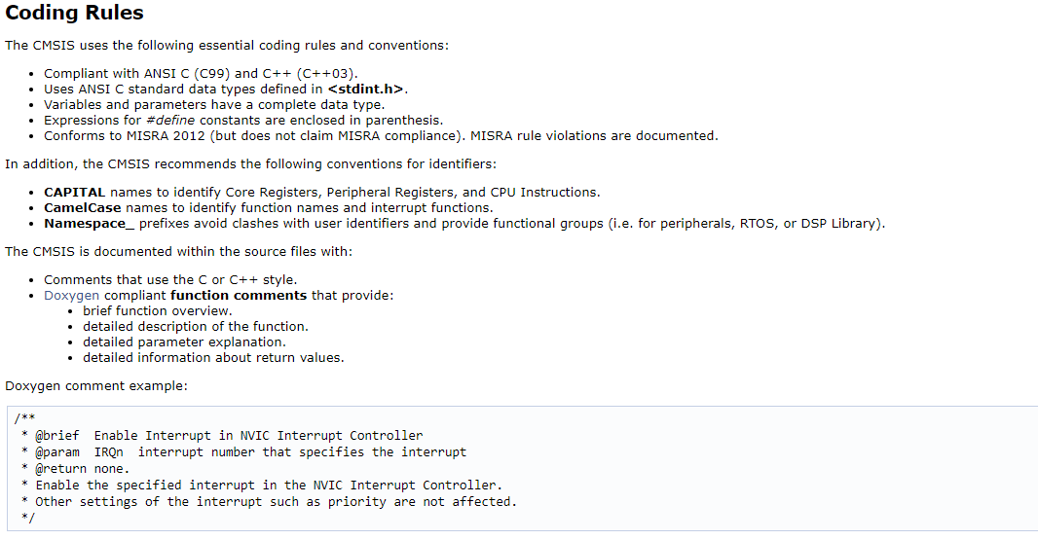
Coding Rules

Slide 14
CMSIS-Core (Cortex-M)
Section 3:

Slide 15
Overview
CMSIS-Core (Cortex-M) implements the basic run-time system for a Cortex-M device and gives the user access to the processor core and the device peripherals. In detail it defines:
- Hardware Abstraction Layer (HAL) for Cortex-M processor registers with standardized definitions for the SysTick, NVIC, System Control Block registers, MPU registers, FPU registers, and core access functions.
- System exception names to interface to system exceptions without having compatibility issues.
- Methods to organize header files that makes it easy to learn new Cortex-M microcontroller products and improve software portability. This includes naming conventions for device-specific interrupts.
- Methods for system initialization to be used by each MCU vendor. For example, the standardized SystemInit() function is essential for configuring the clock system of the device.
- Intrinsic functions used to generate CPU instructions that are not supported by standard C functions.
- A variable to determine the system clock frequency which simplifies the setup the SysTick timer.

Slide 16
Using CMSIS in Embedded Applications
To use the CMSIS-Core (Cortex-M) the following files are added to the embedded application:
Startup File startup_<device>.c (formerly Startup File startup_<device>.s (deprecated)) with reset handler and exception vectors.
System Configuration Files system_<device>.c and system_<device>.h with general device configuration (i.e. for clock and BUS setup).
Device Header File <device.h> gives access to processor core and all peripherals.

Slide 17
Startup File
The Startup File startup_<device>.c (or Startup File startup_<device>.s (deprecated)) is executed after reset and calls SystemInit. After the system initialization control is transferred to the C/C++ run-time library which performs initialization and calls the main function in the user code. In addition the Startup File startup_<device>.c (or Startup File startup_<device>.s (deprecated)) contains all exception and interrupt vectors and implements a default function for every interrupt. It may also contain stack and heap configurations for the user application.

Slide 18
System Configuration Files
The System Configuration Files system_<device>.c and system_<device>.h performs the setup for the processor clock. The variable SystemCoreClock indicates the CPU clock speed. System and Clock Configuration describes the minimum feature set. In addition the file may contain functions for the memory BUS setup and clock re-configuration.

Slide 19
The Device Header File
Peripheral Access provides a standardized register layout for all peripherals. Optionally functions for device-specific peripherals may be available.
Interrupts and Exceptions (NVIC) can be accessed with standardized symbols and functions for the Nested Interrupt Vector Controller (NVIC) are provided.
Intrinsic Functions for CPU Instructions allow to access special instructions, for example for activating sleep mode or the NOP instruction.
Intrinsic Functions for SIMD Instructions [only Cortex-M4 and Cortex-M7] provide access to the DSP-oriented instructions.
Systick Timer (SYSTICK) function to configure and start a periodic timer interrupt.
Debug Access are functions that allow printf-style I/O via the CoreSight Debug Unit and ITM communication.

Slide 20
CMSIS-Core Device Templates
The device configuration of the template files is described in detail on the following pages:
Startup File startup_<device>.c
Startup File startup_<device>.s (deprecated) (deprecated)
System Configuration Files system_<device>.c and system_<device>.h
Device Header File <device.h>

Slide 21

Q&A

Slide 22

Thank you

